Slide 1


TOPIC
Work Smart, Not Hard!
Powerful Time Management
&
Organizing Skills

Slide 2
TRAINING OBJECTIVE
Will provide tools, tips and techniques for increasing personal productivity.
Gain new insights into her/his time management style.
Designed to manage employees time productively and do whatever it takes to create immediate, measurable improvements.
Avoid information overload by identifying causes, screening information, controlling paperwork, using a filing system to organize your office and by communicating effectively.

Slide 3
WHAT YOU WILL LEARN
Techniques for overcoming old habits
Techniques for forming new habits
How to set priorities for work and personal life
How to resolve priority conflicts
How to deal with changing deadlines
How to overcome procrastination
How to delegate effectively

Slide 4

A moment, hour, day or year as indicated by a clock or calendar, 24 hours in a day, 169 hours a week. Nothing more! Nothing less!
What is time ? ?

Slide 5
TIME is irreplaceable & vital, you must develop a system to manage your time.

Slide 6
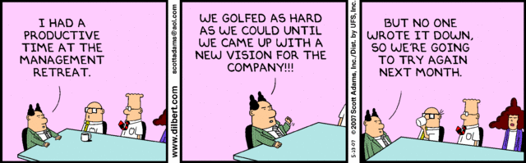
To accomplish most of what you want to do, you must first know HOW you spend your time. Sure, you’re always busy. But are you BUSY or are you PRODUCING?
To accomplish most of what you want to do, you must first know HOW you spend your time. Sure, you’re always busy. But are you BUSY or are you PRODUCING?

Slide 7
through Effective Time Management

Slide 8
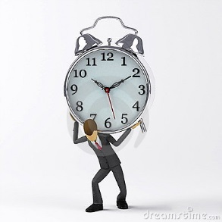
“Time Management is not about time, its about US and HOW WE MANAGE OURSELVES.”

Slide 9

The process of managing and implementing a strategy that assists in making ones life more efficient and productive.
It is one of those areas that is very individual. There are thousands of different techniques to time management, just make sure that which ever you choose is the best one for your lifestyle and organizational style.

Slide 10
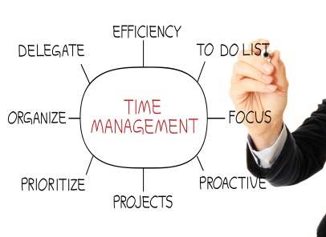

Slide 11

Top 11 time tamers?
How To Plan Your Day?
How To Stop Procrastinating?
How To Prepare For Meetings?
How To Handle Paperwork?
How To Delegate?
How To Get Cooperation from Other Departments?
How To Use E-Mail?
How To Say No?
How To Simplify Your Life?
How to Reduce Stress?
How To Prevent Interruptions?

Slide 12
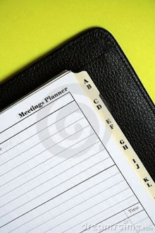
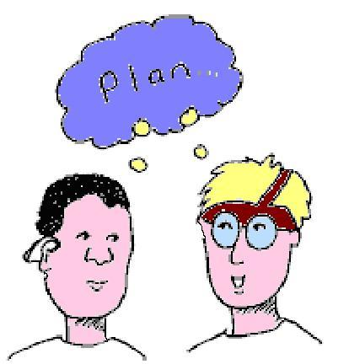
1. How to plan your day

Slide 13
1. How to plan your day
Visualize your long term picture of success and put in writing.
Use planner to keep track of your appointments.
Write out a TO DO LIST every day.
Separate your TO DO LIST according to priorities.
Check off items as you complete them.
Don’t jam your day full of activities.
Be your own manager.
Do it now.
Always plan time for balance.
Review the plan that you have written down at the end of the day.

Slide 14
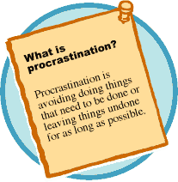
2. How to stop procrastinating

Slide 15


Slide 16
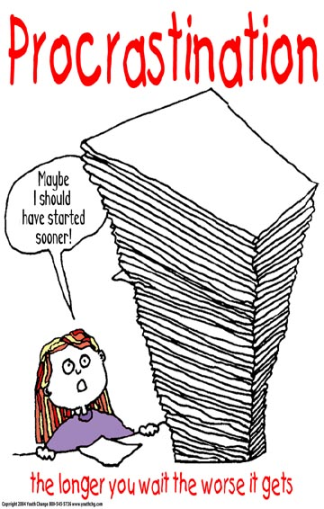

Slide 17
2. How to stop procrastinating?
Recognize that procrastination stems from habit.
Harold Taylor defines procrastination as the intentional and habitual postponement of an important task that should be done now.
Understand the cause of procrastination, then develop strategies to fix it.
Recognize the difference between an appropriate decision to delay, and an irrational postponement without justification.
Fix procrastination by working on:
Task
Environment

Slide 18

A.
Unpleasant tasks
Complex Projects
Indecision
Fear of failure (lack of self confidence)
Lack of Interest
Perfectionism
Hostility towards a boss
Distraction, lack of focus

Slide 19
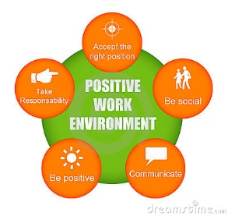
B.
Tailor your environment for work.
Remove distractions.
If you work at home, treat your office as an office.
Tell your family that you are not to be disturbed in your home office.

Slide 20

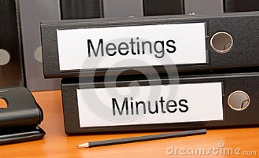
3. HOW TO PREPARE MEETINGS

Slide 21

3. How to prepare for
Make a formal invitation, usually in person or by phone calls at least two weeks in advance.
Send a follow up confirmation note and agenda after attendance has been confirmed.
Determine what items you want to cover.
Distribute the agenda in advance.
Start and finish the meeting with positive items.

Slide 22
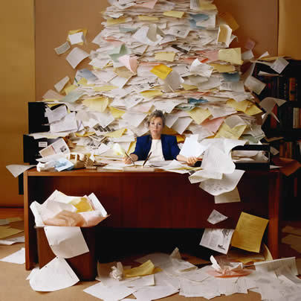
4. How to Handle
Paper Work

Slide 23
4. How to handle paperwork?
Sort through and handle the papers in your tray no more than twice a day.
Avoid the “I’ll just put this here for now” habit.
Throw away previous drafts. They serve no purpose.
Limit the length of letters, recommendations, responses, meetings requests and other correspondence to one page.
Ask people if reports they prepare (or you prepare are really necessary.
Don’t keep copies of all your requests to others, unless there are legal or personnel reasons to do so.
Cut back on sending memos. Use a phone call instead.
Create different file folders.
Don’t keep business cards tucked away in a drawer.
Use Dead File and Archive File accordingly.
Put all your receipts in a small envelope and sort it accordingly.

Slide 24

5. How to Delegate

Slide 25
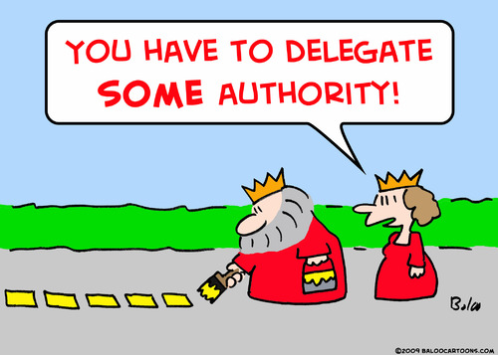
PEOPLE USE MANY EXCUSES FOR NOT
DELEGATING:
I could do better myself.
I don’t know if I can trust her/him to do it.
He/ She isn't qualified to do it.
He/ She doesn’t want any added responsibilities.
I don’t have time to show anyone how to do it.
There is no one else to delegate to.
He/ She already has enough to do.
I don’t want to give up this task because I like doing it.
I'm the only person who knows how to do this.
He/ She messed up last time, so I'm not giving her/him anything else to do.

Slide 26

5. How to delegate?
Delegate Routine Activities:
Fact-finding assignments
Preparation of rough drafts of reports
Problem analysis and suggested actions
Collection of date for reports
Photocopying, printing, collating
Data entry

Slide 27
5. How to delegate?
Delegate, don’t abdicate.
Delegate the objective, not the procedure.
Ask people to provide progress reports.
Delegate to the right person.
Obtain feedback from employees to ensure they feel they're being treated appropriately.
Be sure to delegate the authority along with the responsibility.
Give praise and feedback at the end of the project, and additional responsibilities.

Slide 28

6. HOW TO GET COOPERATION FROM OTHER DEPARTMENTS

Slide 29
6. HOW TO GET COOPERATION FROM OTHER DEPARTMENTS?
In dealing with them, begin with an assumption that they are as competent as your are.
Handle your special requests of other departments as you would handle a task that you would delegate:
Clarify the task to be done and the standards to be met.
Establish a timetable.
Confirm the commitment that they made.

Slide 30
6. HOW TO GET COOPERATION FROM OTHER DEPARTMENTS?
If others let you down; be careful not to react with one of two opposite emotions; aggression and passivity.
Be assertive instead. Use the person’s name. Say please and thank you. Ask don’t tell.
Be straight forward with your request.
Don’t appeal to a higher authority.
Prepare status report of the request from other department.
Convene a meeting to outline your concerns. The other department might identify blocks that can be removed.

Slide 31

6. How to use
E-mail effectively

Slide 32

7. HOW TO USE E-MAIL EFFECTIVELY?
Block off times to process your e-mail. Twice per day should be enough.
Check the spelling & re-read your e-mail before sending it.
DON’T TYPE IN ALL CAPS. This is perceived as shouting.
Sort incoming email by subject, key work, or author so you can process related mail together.
Don’t attach large files without getting permission from your recipients first.
Learn how to keep an address book to save e-mail addresses.
Delete all unnecessary mail.
Delete messages with attachments after you have save them to your hard drive.
Avoid cyber-speak. Not to use acronyms use in e-mail correspondence.

Slide 33

8. How to

Slide 34
7. HOW TO SAY NO!
We say “YES” to others because want to please them. But when eventually we cant continue, we let them down and we feel guilty. Both parties suffer. Recognize that a desire to please often prevents us from saying NO.
Stick to your plan.
Make sure you understand exactly what is being asked of you before you respond.
Be polite, but firm in saying NO.
Provide suggestions or alternatives to the person who is asking.
When in doubt, its easier to say no now, then change your mind to a yes later than to the other way around.

Slide 35
WHEN YOU HAVE TO SAY YES
Sometimes, no is simply unavoidable. Here are some techniques to use:
Tell the person you can agree to their request this time, but ask how the two of you might plan better for the next time.
Tell them YES, but remind them they owe you one.
Tell them yes, but take control by saying you’ll come back to them with a timetable.
Put a tough condition on your agreement.

Slide 36

9. HOW TO SIMPLIFY YOUR LIFE

Slide 37
Think about your values and write down those that really matter to you. What is most important? Spending time with family? Accumulating great wealth? Achieving powerful influence? Acquiring possessions/ Expressing yourself? Learning new ideas? Experiencing adventure and travel? Maintaining excellent health? Socializing with friends? Contributing to the community? You cant do them all. Cut out activities that aren't consistent with your core values.

Slide 38
Write a list of goals you'd like to achieve.
Stop being a slave to communication tools.
Give away clerical tasks to others who can handle non-priority activities.
Cut back on television time.
Clean out your office.
Quit organizations that aren't contributing to your advancement, your network or your fun.
Make a plan for the weekend that doesn’t involve work.
Get rid of unnecessary credit cards and other clutter that you don’t use regularly.
Make time for yourself.
Take a moment each day to be grateful.

Slide 39


10. How to reduce stress

Slide 40

With the SPARKLE Formula:
S - Sleep Well
P - Plan every day
A - Anticipate less
R - Relax
K - Keep Anger under control
L - Laugh
E - Eat Well and Exercise

Slide 41



11. How to prevent interruptions

Slide 42
11. How to prevent interruptions
Prevent interruptions from walk-in visitors by isolating yourself. Close your door.
Block off your time for priorities.
Change the layout of your desk so that your not facing traffic.
If you're strong materials or files that people have to access frequently, move them to another area.

Slide 43
When they walk in
When someone asks for a few minutes of your time, respond with “Sure, how about if I come by your office at ______?
Stop people from telling stories.
If they're asking for help, ask them what solution they propose?
Agree to help them with their request, but schedule a specific time to do it.

Slide 44
Everyone has time robbers in their life: Things that use our time and keep us from doing things that have more value and importance to us.
Time robbers are interruptions, meetings, procrastination and tasks that can be delegated. Also, that prevent you from doing things of greater value and importance.

Slide 45
Remember, time once used, is gone forever! Analyze time to identify problems:
First know yourself.
Do a self assessment, will reveal that you have a good health, have a high energy level and have a good mental attitude without abrupt mood swings.
Appraise your abilities, interests and present situation.
Use sentences like: I am, I can, I need, I desire.
Set your goals high to fulfill the expectations you have for yourself.

Slide 46
PLANNING & GOAL setting are two very important aspects of successful time management. Using the SMART acronym when setting goals:
SPEFICIC – include enough detail so someone else could explain your goal to you.
MEASURABLE – include numbers to monitor progress and tell when the goal is complete.
ACHIEVABLE – make sure the goal is accomplished.
RELEVANT – the goal should relate to your life or business mission.
TIME – the goal must include a deadline or a rate.

Slide 47

CORPORATE
Is the process of both employees and employers working together to most effectively and efficiently deliver the product or service to the customer.

Slide 48

Tips on corporate time management
Each employee should know what they are responsible for, and why their job is important for making the corporation/ service organization successful.
When scheduling appointments make sure that you are scheduling an appropriate amount of time.
When hiring new employees, make sure you take the time to properly train them.
If appropriate implement employee checklists, to minimize waster time.
Try your hardest to only handle paper once.

Slide 49

The hurrier I go, The behinder I get.”

Slide 50

is about personal change!
“If you always do what you always did, you’ll always get what you always got.”

Slide 51
SUMMARY
Time Management is a very hot topic these days whether it be from the personal or corporate point of view. There are many different approaches out there, make sure that you pick up the one(s) that best suits you and your company. Some people feel that an eclectic approach to time management is really the best, which is picking the best points out of several theories and combining them to create a better theory.
Do whatever best suits your personality, lifestyle and career. Only you know the best way to manage YOUR time.
Thin of time management as a process not clear cut solution, as you change so will your time management skills, and techniques.

Slide 52
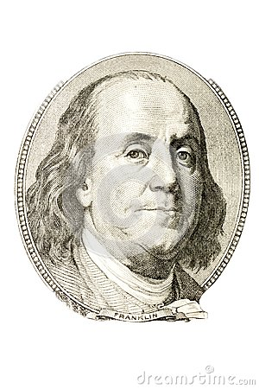
Over two hundred years ago Benjamin Franklin wrote:
“If you want to enjoy one of the greatest luxuries in life, the luxury of having enough time, time to rest, time to think things through, time tog et things done and know you have done them to the best of your ability, remember there is only one way. Take enough time to think and plan things in the order of their importance. Your life will take on a new zest, you will add years to your life, and more life to your years. Let all your things have their places.”

Slide 53
https://www.youtube.com/watch?v=VUk6LXRZMMk

Slide 54

And
HAPPY MANAGING!

Slide 55


