Slide 1


TRAINING COURSE:
Comprehension & Production Skills
Reading
Listening
Speaking
Writing

Slide 2
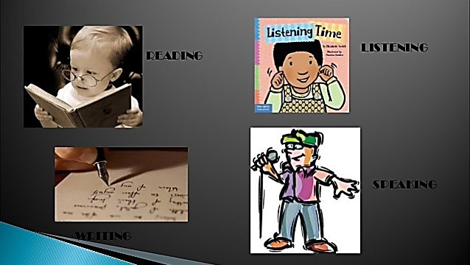
Communication Skills comprises:

Slide 3

TRAINING OBJECTIVE
English has a pre-eminent place in society. A high-quality education in English will teach the employee to speak and write fluently so that they can communicate their ideas and emotions to others, and through their reading and listening, others can communicate with them. Have a chance to develop culturally, emotionally, intellectually, socially and spiritually. Comprehension also enables us both to acquire knowledge and to build on what they already know; A person who do not learn to speak, read and write fluently and confidently are effectively disenfranchised.

Slide 4
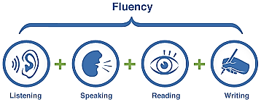
AIMS
The overarching aim for English as the international language is to promote high standards of language and literacy by equipping the staff with a strong command of the spoken and written language, and to develop their love of through widespread reading, writing, listening and speaking for enjoyment.

Slide 5
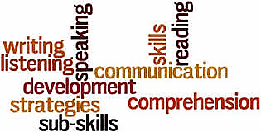
WHAT WILL LEARN
Read easily, fluently and with good understanding
Develop the habit of reading widely and often, for both pleasure and information
Acquire a wide vocabulary, an understanding of grammar and knowledge of linguistic conventions for reading, writing and spoken language
Write clearly, accurately and coherently, adapting their language and style in and for a range of contexts, purposes and audiences
Use discussion in order to learn; they should be able to elaborate and explain clearly their understanding and ideas
Are competent in the arts of speaking and listening, making formal presentations, demonstrating to others and participating in discussion

Slide 6

Comprehension Skills -

Slide 7
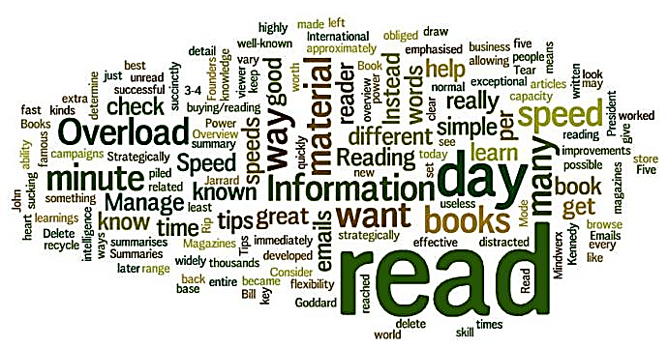
READING SKILLS
Improving your reading skills will reduce unnecessary reading time and enable you to read in a more focused and selective manner. You will also be able to increase your levels of understanding and concentration. This guide shows you how to read with greater efficiency and effectiveness by using a range of different reading skills.

Slide 8

IMPORTANCE OF READING
Have a clear focus for your reading. Set your reading goals.
Survey the text before you spend the time and effort involved in detailed reading.
Scan and skim to select the text for detailed reading.
Scan and skim after detailed reading to reinforce your understanding.
Use a form of note taking whilst reading in detail, to keep you concentrating, aid understanding and provide you with a record of your reading.
Using clear reading goals and a variety of reading skills is more important than increasing your reading speed.
To improve your reading speed, don't increase the speed of the eye across the page, but increase the number of words the eye recognizes in a single fixation.

Slide 9
Watch Video
Learning English - How to Improve Your Reading Skill
https://www.youtube.com/watch?v=0BG-wBBsu5Q

Slide 10



Slide 11


Slide 12

Comprehension Skills -

Slide 13
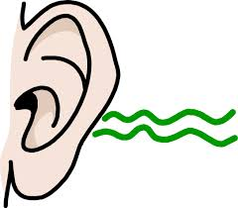
Objective: Listening Skills
Define and understand communication and the communication process
List and overcome the barriers in a communication process
Practice Active Listening
Tips to improve verbal and non-verbal communication

Slide 14

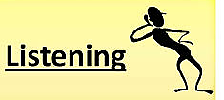
Elements of Effective & Active
Content
Feelings
Process
Clarification

Slide 15

Effective and Active Listening
Effective Listening - Is to listening to the words of the speaker and the meaning of the words.
Active Listening – is a process in which the listener takes active responsibility to understand the content and feeling of what is being said and then checks with the speaker to see if he/ she heard what the speaker intended to communicate

Slide 16
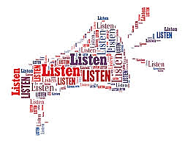
Active Listening Skills
Observe – Non Verbal Behavior
Focus – Don’t do anything else while listening
Acknowledge – Acknowledge the message, even if you don’t agree with it
Respect – Let the speaker finish

Slide 17

Barriers to Effective Listening
We “know” what we are going to hear
We judge delivery [how they said], not content what they say]
We are seeking confirmation, not information
What is being said is getting in the way of what needs be said

Slide 18
Listening Skills
Watch Video
https://www.youtube.com/watch?v=uDVoZ39mONk

Slide 19

L
I
S
T
E
N
- Look interested – get interested
- Involve yourself by responding
- Stay on target
- Test your understanding
- Evaluate the message
- Neutralize your feelings

Slide 20
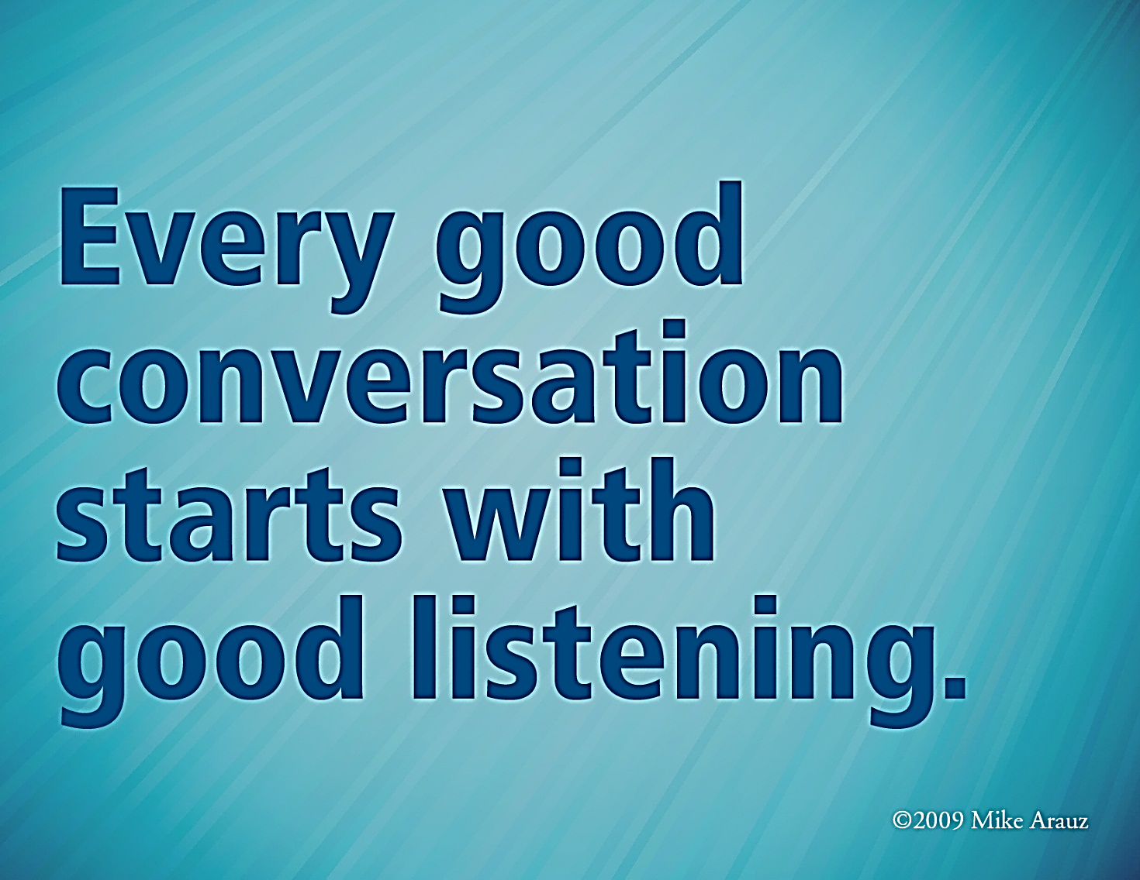

Slide 21
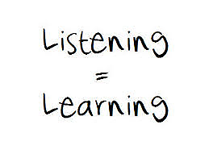

Slide 22

Production Skills -

Slide 23
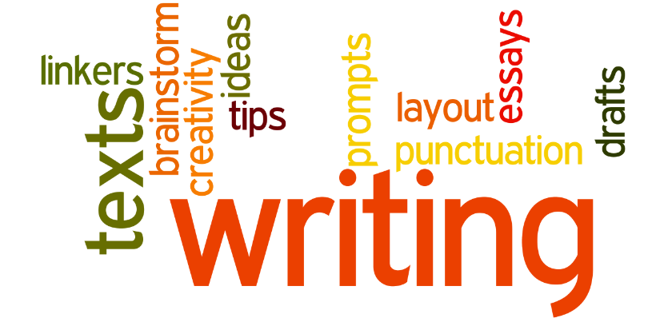
WRITING SKILLS AND TECHNIQUE
PLANNING
Brainstorm and organize ideas
DRAFT
Use your ideas to write a rough draft
REVISE
Make changes to improve your writing
EDIT
Proofread and correct your mistakes
PUBLISH
Write and present your final copy

Slide 24

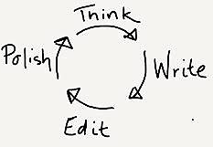
CYCLE IN WRITING

Slide 25

TIPS FOR DEVELOPING YOUR
Think About Your Readers' Needs
Remember Basic Rules for Good Written English
Write Regularly to Develop Confidence and Quality
Have a Structure for Drafting and Re-Drafting
Get Feedback on Your Writing and Use It
Be Realistic About What You Can Achieve

Slide 26
TECHNIQUES TO DEVELOPING YOUR
Use a Variety of Writing Sources
Build your Repertoire – Spell Checks
Using the Internet
Develop Confidence

Slide 27

STRUCTURES

Slide 28

IN WRITING
Avoid excessively long sentences
Do not use a difficult word where a simple one will do
Use punctuation correctly to aid the sense of your writing
Use paragraphs to break your text into logically self-contained units

Slide 29
Watch Video
How to Improve Your English Writing Skills
https://www.youtube.com/watch?v=g0djjrCxuJk

Slide 30
You learn to write
Better by reading.
You learn to read
better by writing.
Reading and writing work
Together to improve your
Ability to think!

Slide 31
WHEN YOU CANNOT THINK: WRITE | WHEN YOU CANNOT SPEAK: WRITE
WHEN YOU CANNOT SLEEP: WRITE | AND IF YOU CANNOT WRITE: READ

Slide 32

Production Skills -

Slide 33
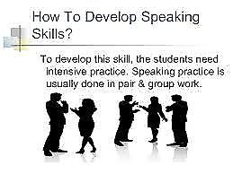
Importance of Speaking Skills
Speaking skills are important for career success, but certainly not limited to one’s professional aspirations. Speaking skills can enhance one’s personal life, thereby bringing about the well-rounded growth we should all seek.
We need to promote this skill among our colleagues and persuade more environmental health professionals to actively participate in events and gatherings, get acquainted with the idea of participation, be willing to share their thoughts, and contribute in any way possible. To enunciate well, perform professionally, and satisfy an audience, one should become familiar with the elements of communication and use them in one's presentations.

Slide 34
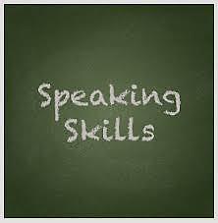
How To Develop
To develop this skill, the employee need intensive PRACTICE.

Slide 35

WHY SHOULD YOU IMPROVE YOUR SPEAKING SKILLS?
Increased confidence
Improved self-esteem
Better overall communication
Advance your career

Slide 36
Watch Video
How to improve your English speaking skills (by yourself)
https://www.youtube.com/watch?v=EK-S1dj6QK8

Slide 37
How to Improve Your English Pronunciation (The First Thing You Must Do)
Watch Video
https://www.youtube.com/watch?v=5l-fo-d0gt8

Slide 38
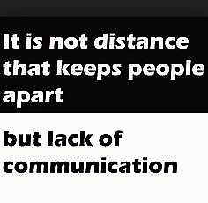

Slide 39


Slide 40


Slide 41


