Slide 1


TOPIC

Slide 2
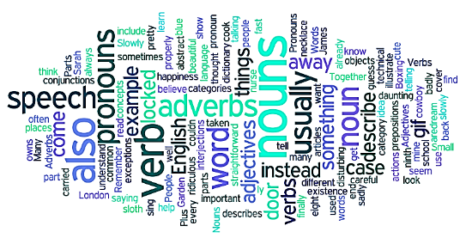

All words in the English language can be classified as one of the eight different parts of speech. Understanding the different parts of speech is important in understanding how words can and should be joined together to make sentences that are both grammatically correct and readable. An understanding of the parts of speech is also important for knowing how to correctly punctuate sentences.

Slide 3
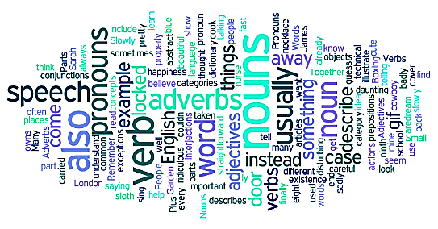
There are eight parts of speech in the English language: noun, pronoun, verb, adjective, adverb, preposition, conjunction, and interjection. The part of speech indicates how the word functions in meaning as well as grammatically within the sentence. An individual word can function as more than one part of speech when used in different circumstances. Understanding parts of speech is essential for determining the correct definition of a word when using the dictionary.

Slide 4
One way to begin studying basic sentence structures in English is to identify the traditional parts of speech (also known as word classes). Here you'll learn the names and basic functions of these eight sentence parts.
As you study the table below, note that only interjections ("Hooray!") have a habit of standing alone (or alongside complete sentences). The other parts of speech--nouns, pronouns, verbs, adjectives, adverbs, prepositions, and conjunctions-- come in many varieties and may appear just about anywhere in a sentence. To know for sure what part of speech a word is, we have to look not only at the word itself but also at its meaning, position, and use in a sentence.
Don't let this variety of meanings and uses discourage you. Keep in mind that learning the names of the basic parts of speech is just one way to understand how sentences are put together.

Slide 5
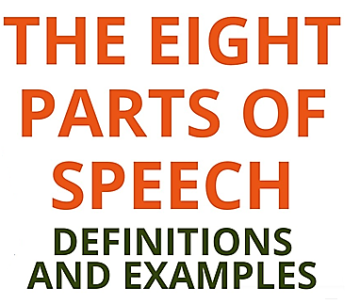

Slide 6
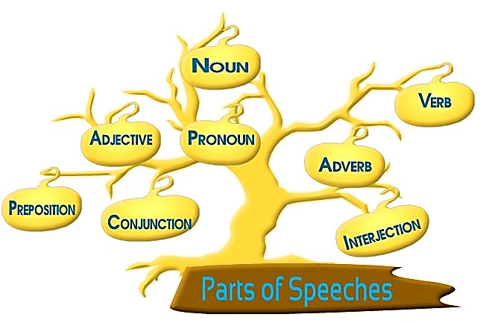

Slide 7
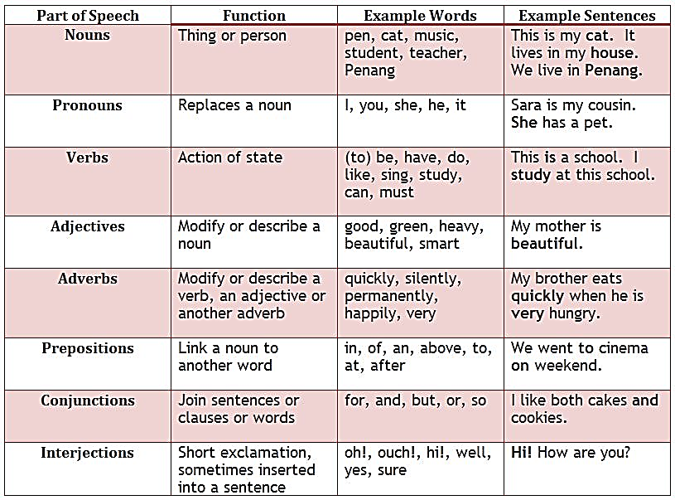

Slide 8
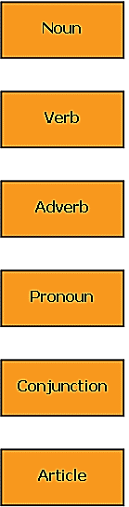
A noun is a naming word. It names a person, place animal, thing or abstract idea.
Examples: doctor, Sydney, cat ticket accident
A verb is a word which expresses an action [doing something] or a state [being something].
Examples: run, sit, tall decide, be.
An adverb is a word that describes the verb. It can indicate the manner, time or place of the action or state.
Examples: quickly, softly, previously, yesterday, often.
A pronoun is a word that takes the place of a noun. It is usually used to avoid repetition of the noun.
Examples: it, I he she, you, my him, us theirs
A conjunction is a word that links words or phrases together.
Examples: and, or but, so because.
An article is a word that introduces a noun.
Examples: the, a an.

Slide 9
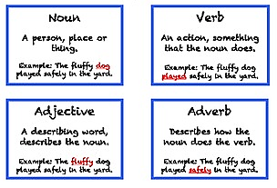

Slide 10
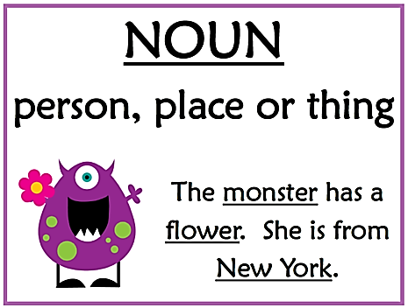
1. NOUN
A noun is the name of a person, place, thing, or idea.
man... Butte College... house... happiness
A noun is a word for a person, place, thing, or idea. Nouns are often used with an article (the, a, an), but not always. Proper nouns always start with a capital letter; common nouns do not. Nouns can be singular or plural, concrete or abstract. Nouns show possession by adding 's. Nouns can function in different roles within a sentence; for example, a noun can be a subject, direct object, indirect object, subject complement, or object of a preposition.
The young girl brought me a very long letter from the teacher, and then she quickly disappeared.

Slide 11
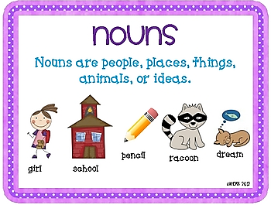
There are different types of nouns namely:
Proper– proper nouns always start with a capital letter and refers to specific names of persons, places, or things.
Examples: Volkswagen Beetle, Shakey’s Pizza, Game of Thrones
Common– common nouns are the opposite of proper nouns. These are just generic names of persons, things, or places.
Examples: car, pizza parlor, TV series
Concrete– this kind refers to nouns which you can perceive through your five senses.
Examples: folder, sand, board
Abstract- unlike concrete nouns, abstract nouns are those which you can’t perceive through your five senses.
Examples: happiness, grudge, bravery

Slide 12
There are different types of nouns namely:
Count– it refers to anything that is countable, and has a singular and plural form.
Examples: kitten, video, ball
Mass– this is the opposite of count nouns. Mass nouns are also called non-countable nouns, and they need to have “counters” to quantify them.
Examples of Counters: kilo, cup, meter
Examples of Mass Nouns: rice, flour, garter
Collective– refers to a group of persons, animals, or things.
Example: faculty (group of teachers), class (group of students), pride (group of lions)

Slide 13
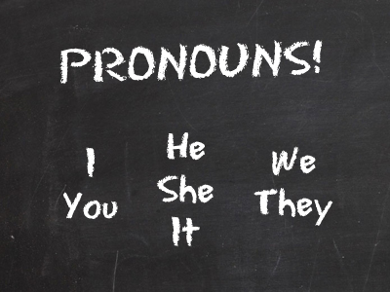
2. PRONOUN
A pronoun is a word used in place of a noun.
She... we... they... it
A pronoun is a word used in place of a noun. A pronoun is usually substituted for a specific noun, which is called its antecedent. In the sentence above, the antecedent for the pronoun she is the girl. Pronouns are further defined by type: personal pronouns refer to specific persons or things; possessive pronouns indicate ownership; reflexive pronouns are used to emphasize another noun or pronoun; relative pronouns introduce a subordinate clause; and demonstrative pronouns identify, point to, or refer to nouns.
The young girl brought me a very long letter from the teacher, and then she quickly disappeared.

Slide 14
Types of Pronouns
Personal Pronouns
refer to people
Examples: |  | Subject |  | Object |  | Possessive Object |  | Possessive Adjective
 |  | I |  | me |  | mine |  | my
 |  | you |  | you |  | yours |  | your
 |  | he |  | him |  | his |  | his
 |  | she |  | her |  | hers |  | her
 |  | it |  | it |  | its |  | its
 |  | we |  | us |  | ours |  | our
 |  | they |  | them |  | theirs |  | their

Slide 15
Relative
introduce certain noun clauses and adjective clauses. The pronoun is sometimes omitted, but is understood.
Example: |  | Persons |  | Things
 |  | who |  | that
 |  | whoever |  | whatever
 |  | whom |  | which
 |  | whomever |  | whose
 |  | whose

Slide 16
Interrogative
introduce a question
Examples: |  | how |  | when |  | which |  | whom |  | why
 |  | what |  | where |  | who |  | whose
Who was there?
Whose coat is this?
What was the outcome of the meeting?
By whom was it written? (the interrogative form is preceded by a preposition)

Slide 17
Demonstrative
refer to the antecedent
Often money is allocated but cannot be spent. This is the case with the hundred thousand earmarked two years ago for the restoration project. (This refers to the whole previous statement.)
Where was the rent money going to come from? How was he going to feed and clothe himself? These were the questions that remained unanswered. (These refers back to the two questions.)
“Feeling guilty—that is what life’s about,” Mary explained. (The antecedent for that is feeling guilty.)
Part of her diary covers the years 1932 to 1934. For the Lenke family, those were the hardest years. (The antecedent for those is the years 1932 to 1934.)
Examples: |  | that |  | these |  | this |  | those

Slide 18
Reflexive
reflect back to the antecedent
can be used to intensify the antecedent
can be used only when the personal pronoun to which it refers has been used in the sentence
I myself have misjudged people on occasion.
Jess was able to read by himself when he was only four years old.
It was his regret that his dear mother could not keep her thoughts to herself.
Singular |  | Plural
myself |  | ourselves
yourself |  | yourselves
himself |  | themselves
herself
itself

Slide 19
Reciprocal
refer to individual parts of a plural antecedent
Out of respect for each other, Lisa and Joan agreed to disagree. (The plural antecedent is Lisa and Joan.)
Lisa and Joan have been avoiding one another for the past week. (One another is more formal than each other, and can be used to refer to more than two.)
Examples: |  | each other |  | one another

Slide 20
Indefinite
refer to nonspecific (indefinite) persons or things
Everyone has been asked to donate a dollar.
By the look of things, nobody has lived in this house for years.
Whoever lived here last must have welcomed death.
Examples: |  | everyone |  | everybody |  | everything |  | everywhere |  | whoever
 |  | someone |  | somebody |  | something |  | somewhere |  | another
 |  | anyone |  | anybody |  | anything |  | anywhere |  | each
 |  | no one |  | nobody |  | nothing |  | nowhere |  | either
 |  | one |  | neither |  | person

Slide 21
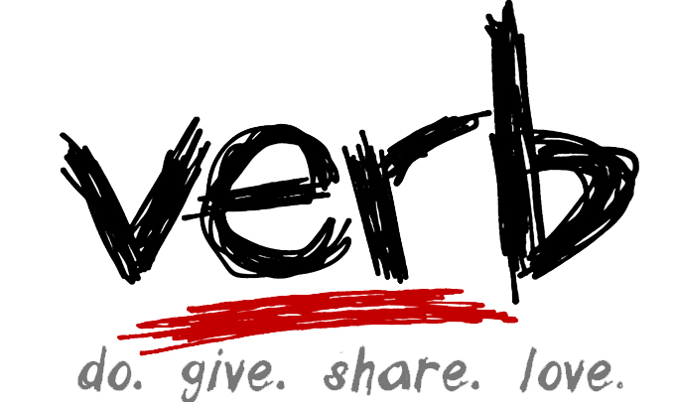
3. VERB
A verb expresses action or being.
jump... is... write... become
The verb in a sentence expresses action or being. There is a main verb and sometimes one or more helping verbs. ("She can sing." Sing is the main verb; can is the helping verb.) A verb must agree with its subject in number (both are singular or both are plural). Verbs also take different forms to express tense.
The young girl brought me a very long letter from the teacher, and then she quickly disappeared.

Slide 22
Principal Parts to the Verb
Notice that past and past participle forms for regular verbs end with -ed. For other verbs, please see Irregular Verbs. All verbs, however, are regular in the present participle form. The only changes that occur are a result of spelling. All verbs add -ing to the base form.
 |  | Regular Verbs
Examples: |  | Base Form |  | Past |  | Past Participle |  | Present Participle
 |  | consider |  | considered |  | considered |  | considering
 |  | indicate |  | indicated |  | indicated |  | indicating
 |  | model |  | modelled |  | modelled |  | modelling
 |  | walk |  | walked |  | walked |  | walking

Slide 23
Spelling rules:
If the base form ends in e, omit the e and add ing
e.g., bite ® biting
If the base form ends in a single vowel followed by a consonant, double the final consonant and add ing (British and Canadian spelling)
e.g., travel ® travelling
If the base form ends in ie, change the ie to y and add ing
e.g., die ® dying

Slide 24
Types of Verbs
Transitive
require an object; without an object the sentence or thought is incomplete
Incorrect: | I like. (Like what? This is not a complete thought, so clearly an object is required.)
Correct: | I like coffee. (Coffee is the object. The sentence is now complete.)
Incorrect: | Hundreds of protesters hurled. (Hurled what? This is not a complete thought.)
Correct: | Hundreds of protesters hurled stones and vegetables at police guarding the courthouse. (Stones and vegetables is the object of hurled.)

Slide 25
Intransitive
do not require an object to make the sentence or thought complete
Birds fly.
She awoke much later than she’d intended.
He hurried along the sidewalk, side-stepping as many puddles as he could.

Slide 26
Stative or Linking
indicate a state of being or condition because they link the subject of a sentence with a noun, pronoun or adjective, anything that identifies the subject
The most common linking verb is to be. Other frequently used linking verbs are as follows:
Michael is my eldest brother. (My eldest brother is the noun phrase that identifies Michael. Without the noun phrase, the sentence would be incomplete.)
The soup still tasted bland. (Bland is an adjective that describes soup. The adjective is necessary to complete the sentence.)
Examples: |  | appear |  | feel |  | look |  | seem |  | sound
 |  | become |  | grow |  | remain |  | smell |  | taste

Slide 27
Auxiliary (sometimes called helping) verbs
are used to indicate tense. The following tenses require auxiliary verbs: present, past, and future progressive (continuous or continued action); simple future; present, past, and future perfect. Auxiliary verbs are always used with a main verb, the word that expresses the action or state to indicate when and for how long an action occurs. Two tenses, the simple present and the simple past, however, do not use auxiliary verbs.
are used to form interrogatives (questions) and negatives. When referring to present and definite past situations, the auxiliaries do, does, did are required.
are used to form tag questions that are placed after a statement.
are used to answer yes/no questions. A yes/no question that starts with a negative construction asks for confirmation of a known or suspected situation.
are used to provide emphasis in the simple present tense by using do.
Examples: |  | am |  | be |  | did |  | does |  | have |  | shall |  | would
 |  | are |  | been |  | do |  | had |  | is |  | will

Slide 28
Modal
A modal provides additional information about a main verb; it adds a sense of obligation, possibility, ability or permission.
Examples: |  | can, could, be able to |  | have to |  | must |  | would
 |  | can’t |  | may |  | shall
 |  | have got to |  | might |  | should
When referring to obligations, ability, possibility, or permission in the past or when speculating about events in the past, modal verbs are followed by have + past participle.
When referring to obligations, ability, possibility, or permission in present or future situations, modal verbs are followed by the infinitive (base form of the verb).
When referring to obligations, ability, possibility, or permission in the past or when speculating about events in the past, modal verbs are followed by have + past participle.

Slide 29
Verbals
A verbal is a word derived from a verb but which functions as a noun, adjective, or adverb.
Infinitives
name an action, state or condition when they function as a noun
describe or modify the noun or verb when they function as an adjective or adverb
To argue is futile. (To argue is a noun here. It is the subject of this sentence.)
He likes to talk. (To talk is a noun here. It is the object of likes.)
It is time to go. (To go is an adjective, modifying time.)
He had enough money to spare. (To spare is an adjective, modifying money.)
He is helping to load the truck. (To load is an adverb, modifying helping.)
We are ready to go. (To go is an adverb, modifying ready.)

Slide 30
Past participles
function as an adjective to describe or modify a noun
Tired and a little sickened, Paul Bradley opened his bedroom window to release the cigarette smoke. (Tired and sickened are adjectives describing Paul Bradley.)
Married herself, Lydia had little difficulty empathizing with her neighbor's dissatisfaction. (Married is an adjective describing Lydia.)

Slide 31
Present participles
function as an adjective to describe or modify the noun
Moving away from the mirror, Sonia considered last night’s debate. (Moving is an adjective describing Sonia.)
Laughing, he scrambled up the hillside. (Laughing is an adjective describing he.)
He jumped from the top diving board. (Diving is an adjective modifying board.)

Slide 32
Gerunds
function as a noun to name an action, state or condition
Reading is a skill that is difficult to master. (Reading is a gerund and is the subject of the sentence here.)
I tried pushing the car to get it out of the snow. (Pushing is a gerund and is the object of the verb tried.)

Slide 33
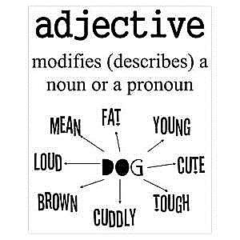
4. ADJECTIVE
An adjective modifies or describes a noun or pronoun.
pretty... old... blue... smart
An adjective is a word used to modify or describe a noun or a pronoun. It usually answers the question of which one, what kind, or how many. (Articles [a, an, the] are usually classified as adjectives.)
The young girl brought me a very long letter from the teacher, and then she quickly disappeared.

Slide 34
Types of adjectives
Of quality
The little girl played with a round, yellow ball.
He wore a thin, blue silk scarf round his neck.
Examples: |  | round, yellow, thin, heavy, silk, etc.

Slide 35
Demonstrative
This purple skirt is a better bargain than that one.
These lettuces look fresher than those over there.
This, that, these, and those function as adjectives here, not as pronouns. As adjectives, they are adding to the reader’s understanding of the nouns, not referring to the antecedent as they would do if they were functioning as pronouns, as below:
That is not a relevant question. (That is a pronoun here referring to the previous sentence.)
Examples: |  | this, that, these, those

Slide 36
Distributive
Each student should have his own personal copy of the text.
Every citizen over the age of eighteen has the right to vote.
Either pen will do.
Neither proposal was accepted.
Each, every, either, and neither function as adjectives here because they add meaning to the reader’s understanding of the noun they precede. If they were pronouns they would refer to the antecedent as in the following:
Six students attended the seminar. Each contributed to the discussion. (Each is a pronoun here referring to students.)
Examples: |  | each, every, either, neither

Slide 37
Quantitative
She dug out a few grubby coins from the bottom of her bag.
Did you offer your grandmother some tea?
Six years later, the insurgents are struggling to survive along the country’s eastern border.
No objections to the hiring were raised.
Examples: |  | some, any, no, few, many, much, one, two, etc.

Slide 38
Interrogative
To which university did she apply?
What scoundrel dares disturb my sleep in this fashion?
Whose coat is this?
Examples: |  | which, what, whose

Slide 39
Possessive adjective pronouns
These adjectives affect the meaning of the noun that follows.
He laid his jacket neatly over the back of the chair.
Traditional economic theories assume that people save or borrow so as to spread their income over their lifetime.
Examples: |  | their, my, your, his, her, its, our, your

Slide 40
Possessive nouns
The University’s Educational Services department organizes on-site programmes.
Have you seen Adam’s new car?
The possessive noun modifies or adds to the reader’s understanding of the following noun.
Examples: |  | the University’s, Peter’s, New York’s, etc.

Slide 41
Articles
A, an, and the can also be considered adjectives because they affect the reader’s understanding of the noun that follows.
A girl crossed the road. (The A tells the reader that there is only one girl, and also that the girl is unknown to the writer.)
The girl crossed the road. (The tells the reader that there is one girl, but she is familiar to the writer.)

Slide 42
Proper adjectives
adjectives derived from nouns
We were served by a Spanish waiter who could barely speak English. (Spanish is a proper adjective used to describe waiter.)
In the corner of the room stood an old, Victorian desk. (Victorian is a proper adjective used to describe desk.)
Examples: |  | Spanish, Moslem, Biblical, Victorian, etc.

Slide 43
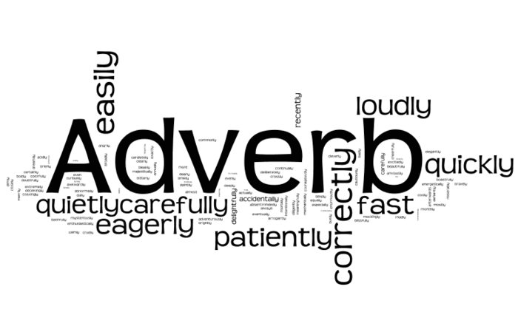
5. ADVERB
An adverb modifies or describes a verb, an adjective, or another adverb.
gently... extremely... carefully... well
An adverb describes or modifies a verb, an adjective, or another adverb, but never a noun. It usually answers the questions of when, where, how, why, under what conditions, or to what degree. Adverbs often end in -ly.
The young girl brought me a very long letter from the teacher, and then she quickly disappeared.

Slide 44
The different types of adverbs are:
Adverb of Manner– this refers to how something happens or how an action is done.
Example: Annie danced gracefully.
The word “gracefully” tells how Annie danced.
Answer the question how?
Examples: carefully, courageously, cheerfully, hard, fast, well, etc.
He climbed the ladder carefully.
She smiled cheerfully.
You’re looking well these days.

Slide 45
Adverb of Place– this tells something about “where” something happens or ”where” something is done.
Example: Of course, I looked everywhere!
The adverb “everywhere” tells where I “looked.”
Answer the question where?
Examples: above, across, here, there, before, behind, etc.
The sculpture sat next to the fireplace. The painting hung above. (Above is an adverb here modifying hung.)
She sat across the room from me. (Across modifies the verb sat.)

Slide 46
Adverb of Degree– this states the intensity or the degree to which a specific thing happens or is done.
Example: The child is very talented.
The italicized adverb answers the question, “To what degree is the child talented?”
Examples: very, fairly, rather, quite, so, too, hardly, etc.
She walked very slowly towards the cliff’s edge.
He talked so quietly that listening was a strain.
I hardly know what to say.
Kate rather liked Simon’s impish ways.

Slide 47
Adverb of Time- this states “when” something happens or “when” it is done.
Example: She came yesterday.
The italicized word tells when she “came.”
answer the question when?
Examples: now, soon, yet, still, today, already, afterwards, recently, tomorrow, etc.
You can take a break now, if you like.
There were other students still to come.
Not all the registered guests have arrived yet.

Slide 48
Adverb of Frequency
Answer the question how often?
Examples: twice, often, seldom, rarely, hardly ever, sometimes, etc.
•Rarely had he been so moved by a performance.
She often despaired of the human race.
We hardly ever eat out.

Slide 49
Adverb of Certainty
Examples: absolutely, certainly, definitely, obviously, surely, etc.
He certainly seemed upset.
The teacher was obviously annoyed with Jack for handing in his assignment so late.
The product is definitely improved.

Slide 50
Interrogative
when? = at what time?
where? = in what place?
why? = for what reason?
how? = in what way?
When did you hear about it?
How was she sitting?
Where was the car parked?
How often do you hear from your family?

Slide 51
Relative
•are used to introduce adjective (relative) clauses in the same way that relative pronouns are used in such clauses.
Examples: when, where
•July 1st is when Canadians celebrate Canada Day.
The hotel where we stayed overlooked the sea.

Slide 52
Conjunctive Adverbs
A conjunctive adverb modifies the action by creating logical connections in meaning between independent clauses. Unlike conjunctions, conjunctive adverbs are not always at the beginning of the clause.

Slide 53
Types of Conjunctive Adverbs
Of addition
Examples: also, besides, furthermore, moreover, etc.
The condo complex has tennis courts; besides this, it has an indoor pool.
He must have got stopped at the border crossing; otherwise, he would have arrived by now.
The lecturer had a monotonous voice; furthermore, he jumped from one idea to another so that the lecture was very difficult to follow.

Slide 54
Of contrast
Examples: However, still, nevertheless, conversely, nonetheless, instead, etc.
The printers are on strike; registered students will, nevertheless, receive course packages on time.
We were able to run only four courses; still, this compares favorably with other summer programs.
It’s really cold today; we can’t complain, however, as it’s been mild overall.

Slide 55
Of comparison
Examples: similarly, likewise
Paul went to Lakeland college; his daughter, likewise, did her studies there.
Kate is engrossed in her dogs; Martha is similarly obsessed with her horses.

Slide 56
Of result
Examples: therefore, hence, thus, consequently, etc.
He rarely produced a day’s work; he consequently lost his job.
Caffeine is a stimulant; thus, it can keep a person awake at night.
We discovered Ida’s activities were duplicating those of Marla; we, therefore, assigned Ida other tasks.

Slide 57
Of time
Examples: next, then, meanwhile, finally, subsequently, etc.
The chairman will be late for the meeting; meanwhile, we’re to hand out minutes of the last meeting to the board members.
The network has crashed; next, the power will go off.
First boil the water; then, pour it over the tea bag.

Slide 58
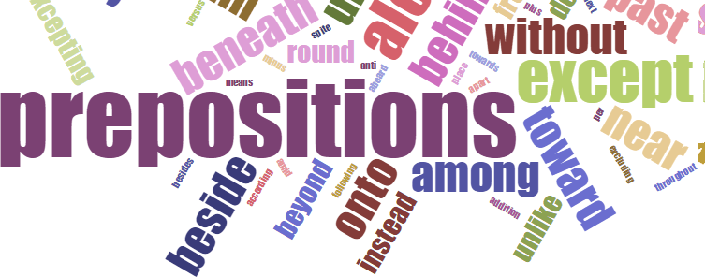
6. PREPOSITION
A preposition is a word placed before a noun or pronoun to form a phrase modifying another word in the sentence.
by... with.... about... until
(by the tree, with our friends, about the book, until tomorrow)
A preposition is a word placed before a noun or pronoun to form a phrase modifying another word in the sentence. Therefore a preposition is always part of a prepositional phrase. The prepositional phrase almost always functions as an adjective or as an adverb. The following list includes the most common prepositions:
The young girl brought me a very long letter from the teacher, and then she quickly disappeared.

Slide 59
The following is a list of commonly used prepositions. The list is by no means comprehensive.
Examples: |  | about |  | below |  | from |  | over |  | until
 |  | above |  | beside |  | in |  | past |  | up
 |  | across |  | between |  | into |  | since |  | with
 |  | along |  | by |  | of |  | through |  | within
 |  | at |  | down |  | of |  | to |  | without
 |  | before |  | during |  | on |  | towards
 |  | behind |  | for |  | outside |  | under

Slide 60
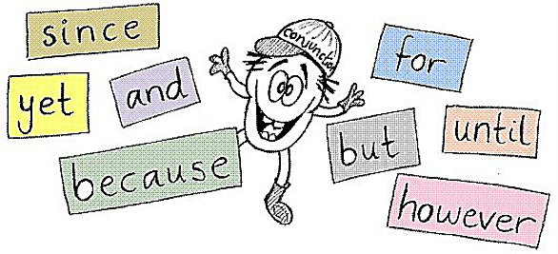
7. CONJUNCTION
A conjunction joins words, phrases, or clauses.
and... but... or... while... because
A conjunction joins words, phrases, or clauses, and indicates the relationship between the elements joined. Coordinating conjunctions connect grammatically equal elements: and, but, or, nor, for, so, yet. Subordinating conjunctions connect clauses that are not equal: because, although, while, since, etc. There are other types of conjunctions as well.
The young girl brought me a very long letter from the teacher, and then she quickly disappeared.

Slide 61
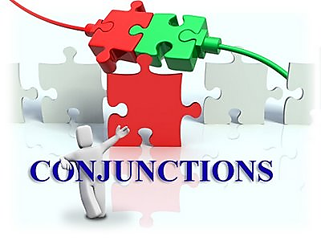
Types of Conjunctions
Coordinating conjunctions
join grammatically equivalent sentence elements
Edmonton and Calgary are the two largest cities in Alberta. (And joins two nouns.)
Look in the cupboard or in the drawer. (Or joins two phrases.)
You can’t do that kind of heavy work, nor should you be expected to. (Nor joins two clauses.)
Examples: |  | and |  | for |  | or |  | yet
 |  | but |  | nor |  | so

Slide 62
Correlative conjunctions
pairs of words that join words, phrases, and clauses of equivalent grammatical structure
Both Susan and Bill received their ten-year pin this year.
Either you get a job or you go back to school.
Whether you stay or leave is entirely your decision.
Examples: |  | both . . . and
 |  | either . . . or
 |  | neither . . . nor
 |  | not . . . but
 |  | not only . . . but (also)
 |  | whether . . . or

Slide 63
Subordinating conjunctions
These join clauses that are not equivalent grammatical structures. Subordinating conjunctions introduce dependent clauses. These clauses cannot stand by themselves but must be joined to a main or independent clause.
The following is a list of words most often used as subordinating conjunctions:
In order to make feasible projections, we need to have reliable data.
He’s taller than you are.
He looks as if he were about to cry.
Examples: |  | after |  | even though |  | than |  | wherever
 |  | although |  | if |  | that |  | whether
 |  | as |  | in order that |  | though |  | which
 |  | as if |  | in order to |  | unless |  | while
 |  | as though |  | rather than |  | until |  | who
 |  | because |  | since |  | when
 |  | before |  | so as to |  | whenever
 |  | even if |  | so that |  | where

Slide 64
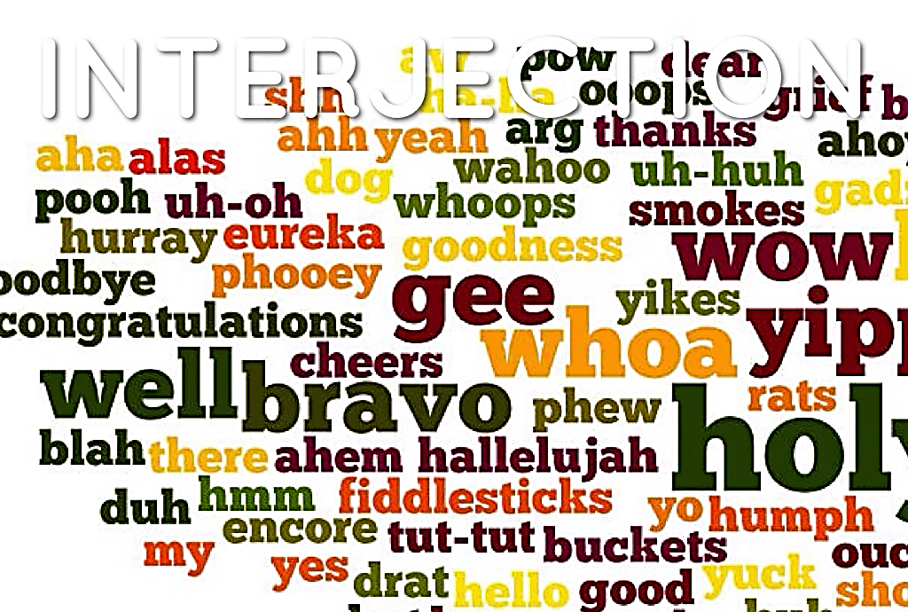
8. INTERJECTION
An interjection is a word used to express emotion.
Oh!... Wow!... Oops!
An interjection is a word used to express emotion. It is often followed by an exclamation point.
Sample Sentences:
Ouch! That must have hurt.
Hurray, we won!
Hey! I said enough!

Slide 65
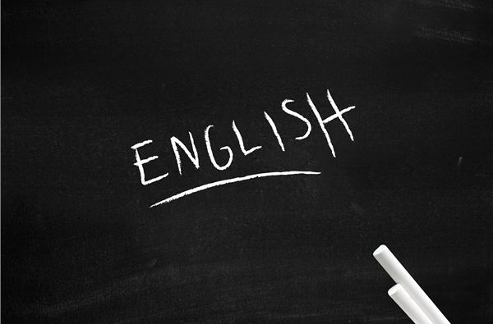
Final Thoughts
You must familiarize yourself with the different parts of speech discussed in this session because they are among the most fundamental concepts that you will encounter throughout your career. An in-depth knowledge of this topic will not only make you a better writer in comprehension, but an effective communicator as well.

Slide 66


