Slide 1

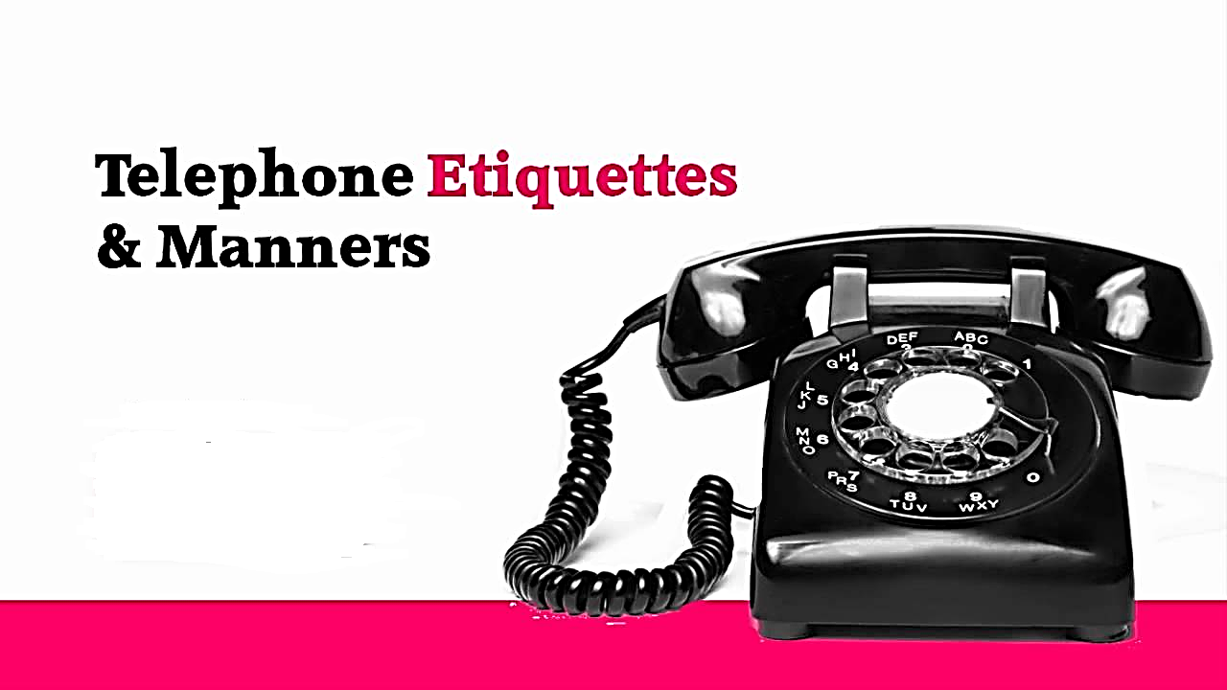

Slide 2
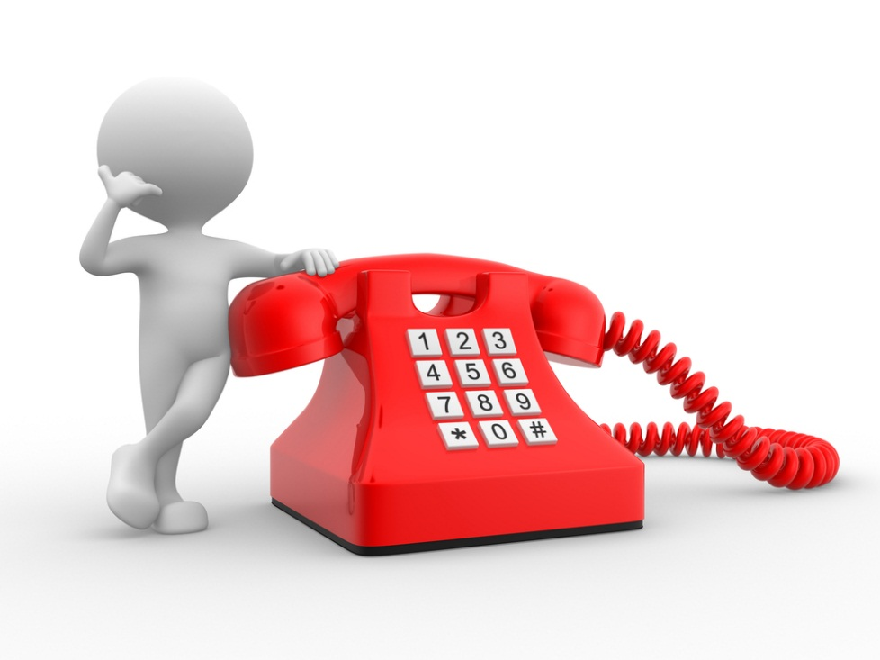
Objectives
Answering Calls
Tactful Responses
Taking Messages
Handling Rude Callers
Making calls
Ending Conversations
Voicemail Etiquette
Caller Complaints

Slide 3
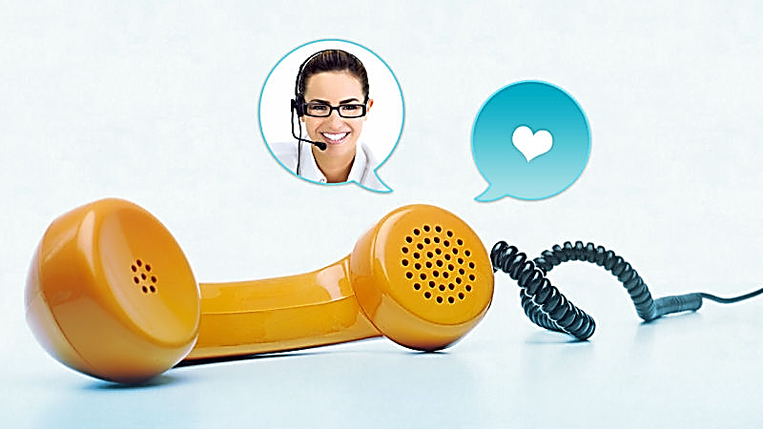
Answering Calls For Your Department
–Answer promptly
•Before third ring if
possible
–Discontinue all activities
•Other conversations
•Eating
•Chewing gum
•Typing
–Speak clearly
•Use pleasant tone
– Identify yourself
•“This is _____.”
– Listen
•Do not interrupt
– Use hold button
•Caller won’t hear
nearby conversations
– Explain transfers
•Why and where

Slide 4

General Guidelines
•Get the best time and phone number to be
reached if taking a message.
•Do not call before 8 a.m. or after 9 p.m. unless
you have specific permission.
•Don’t make a habit of receiving personal calls at
work.
•Don’t handle a rude caller openly at the service
desk or call center.

Slide 5
Tactful Responses
What You Mean: | Tell the Caller:
"He is out." | "He is not in the office at the moment. Would you like to Leave a message on his voice mail?"
"I don't know where he is." | "He has stepped out of the office. Would you like to leave a Message on his voicemail?"
"He is in the men's room." | "He has stepped out of the office. Would you like to leave a Message on his voicemail?"
"He hasn't come in yet." | "I expect him shortly. Would you like to leave a message on His voicemail?"
"She took the day off." | "She is out of the office for the day. Can someone else help You or would you like her voicemail?"
"He doesn't want to be disturbed." | "He is unavailable at the moment. Would you like to leave a Message on his voicemail?"
"She is busy" | "She is unavailable at the moment. Would you like to leave a Message on her voicemail?"

Slide 6
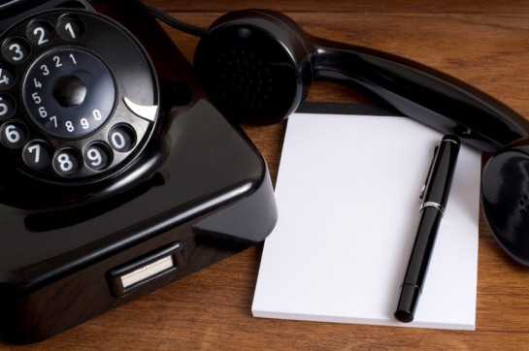
Taking Messages
– Be Prepared
• Pen and paper
– Ask For:
• Caller’s name with correct spelling
• Caller’s phone number
• What the call is in regards to
– Repeat Message to Caller
– Notate Date & Time
*Don’t forget to give the message to the intended recipient!

Slide 7
Handling Rude Callers
–
–
–
–
Stay calm, speak slowly, clearly and calmly
Remain diplomatic & polite
Show willingness to resolve problem
Don’t over-react to trigger words
• Callers will often try to push your buttons
– Listen completely to the complaint, allow the caller to vent
• Only when they are finished should you comment
– Long-distance calls
• Offer to call them back to avoid phone charges - this can have an immediate
positive impact
– Acknowledge their feelings
• “I can hear that you are upset by this” or “I can tell this situation is upsetting
you”.

Slide 8
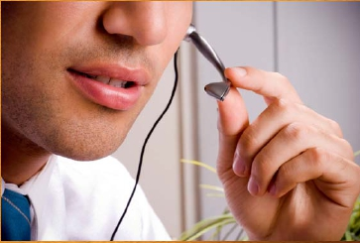
Making Calls
–Identify yourself first
–State purpose of the
communication
–Ask questions if needed to
get to correct dept/person
–Reached a wrong number
•Say: “I’m sorry, I must
have the wrong number.
Please excuse the
interruption.” And then
hang up.

Slide 9
Ending Conversations Gracefully
Ways to end a long phone call:
– Leave conversation open
– Promise to finish conversation at another time
– End on an “up” note

Slide 10

Voicemail Etiquette
–Update greeting regularly
–Let callers know when you
will return their call
–Extended absences
•Let callers know when you
will be returning and how
they can contact an alternate
person if needed.
–Keep It Short & Simple
(KISS)
• Keep recording to a
maximum of about 15
seconds
–Take your time while
recording, and sound
sincere
–Check messages daily
–Return messages within 24
hours

Slide 11
Frequent Caller Complaints
• The telephone rings for a long time before it is
answered.
• They place me on hold for a long time.
• The line is always busy.
• They don’t listen to my needs before transferring me.
• I get disconnected while being transferred.
• The person says “wait” and talks to other coworkers
without putting me on hold.
• They answer with an aggravated voice.

Slide 12
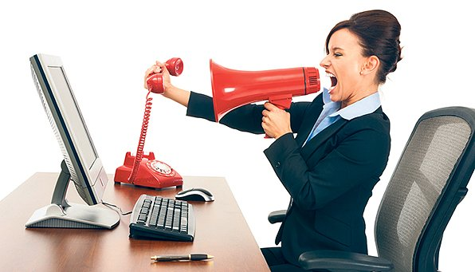
Telephone
Etiquette Summary
•Think about if you were the person on the
other side of the line; how would you want to
be treated?
•Give respect, get results.
•“Smile” while you’re on the phone – it will
make a huge impact on your communications!
•Customer service can be hard work!

